Slide 1
Bats a Fact! Quiz

Slide 2
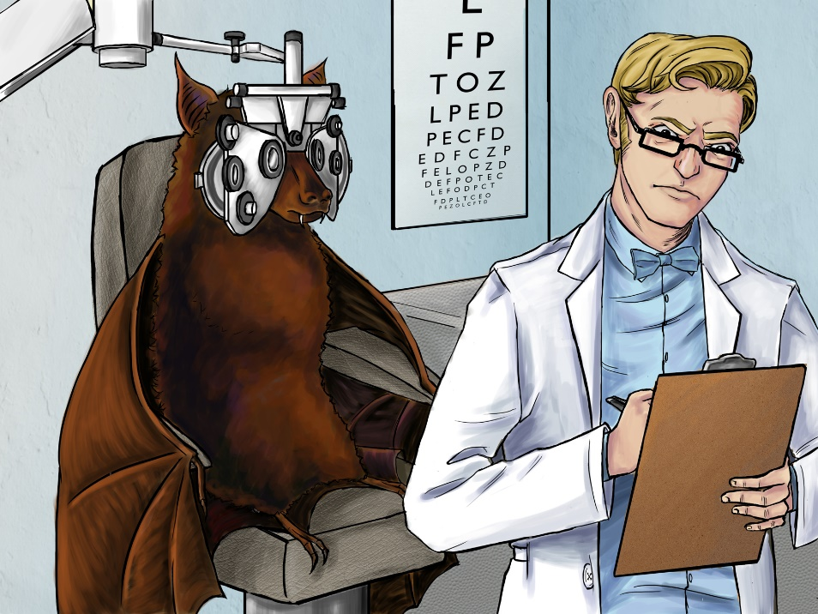
TRUE OR FALSE
BATS ARE BLIND?

Slide 3
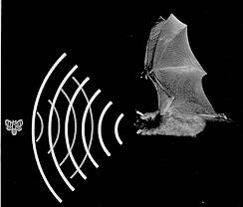
FALSE!
Bats can see just as well as we can, only better! They use echolocation to hunt for prey and find their way in the dark

Slide 4
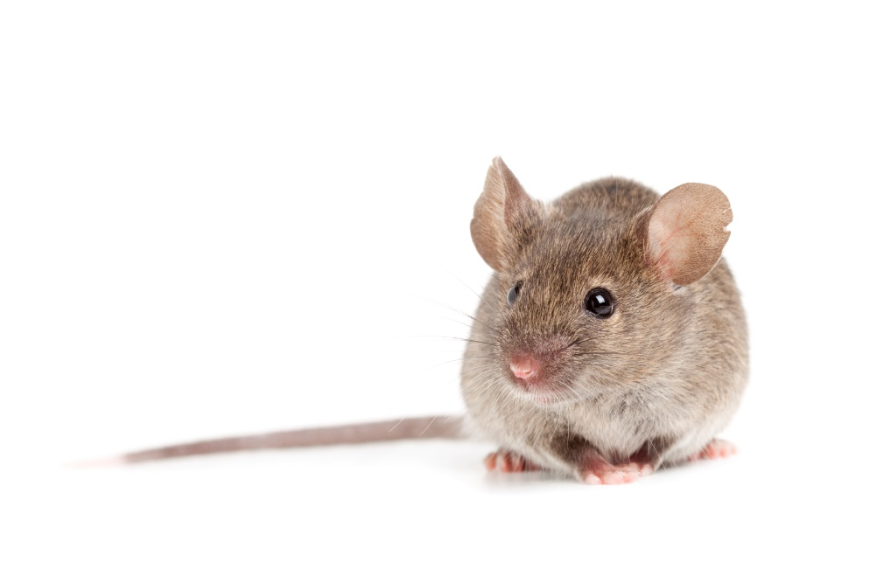
TRUE OR FALSE
Bats are rodents just like rats and mice?

Slide 5
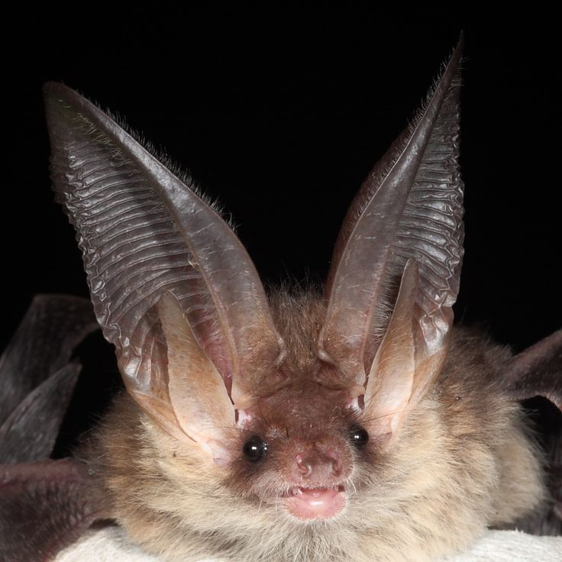
FALSE!
Bats are more related to dogs than they are to rats or mice.
- Bats do not build nests
- Bats do not chew wires or cause damage to buildings
- Bats don’t bring food into their roost
- Bats only have 1 pup each year or occasionally twins.

Slide 6
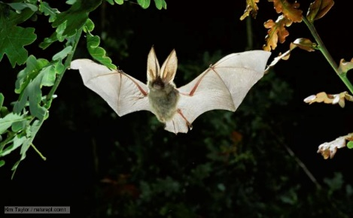
TRUE OR FALSE
Bats get tangled in your hair?

Slide 7
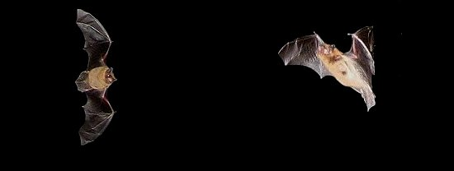
FALSE!
Bats may fly close to you to feed on the midges surrounding you. They are not trying to get into your hair.
A young bat learning to fly may collide with you – but very rarely and accidentally!

Slide 8
CAN YOU NAME THREE THINGS OUR BATS MIGHT EAT?

Slide 9
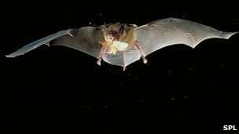
ANY OF THESE! Irish and UK bats are insectivores
MIDGES
MOTHS
SPIDERS
BEETLES
MOSQUITOES

Slide 10
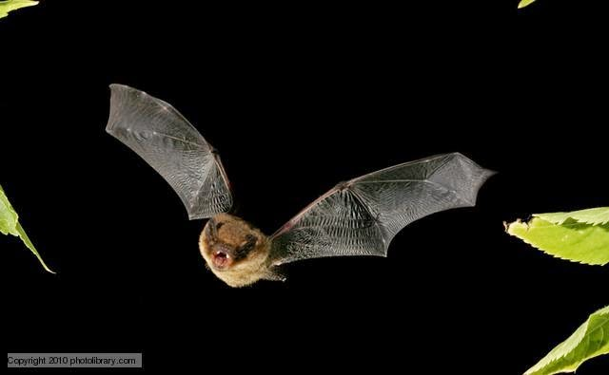
GUESS HOW MANY
How many midges does a bat eat in one night?

Slide 11
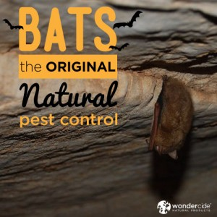
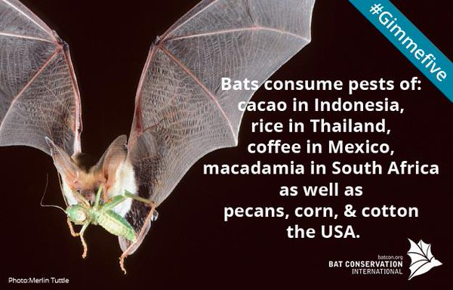
Over 3000!
Bats are the best natural pest controllers in the world

Slide 12
WELL DONE!!

