Slide 1
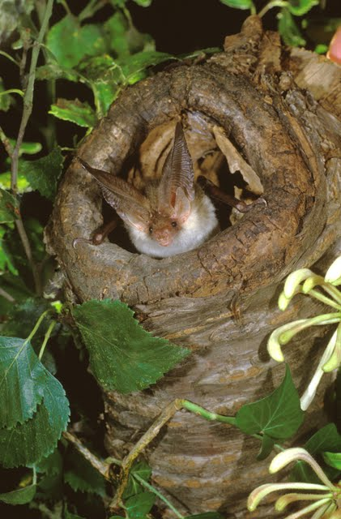
Bats a Fact Quiz

Slide 2
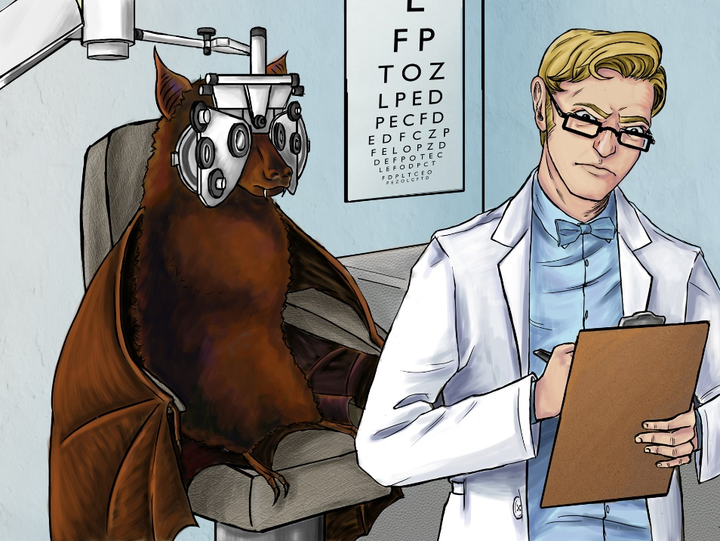
TRUE OR FALSE
BATS ARE BLIND?

Slide 3
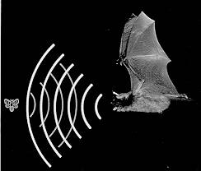
FALSE!
Bats can see just as well as we can, only better! They use echolocation to hunt for prey in the dark

Slide 4
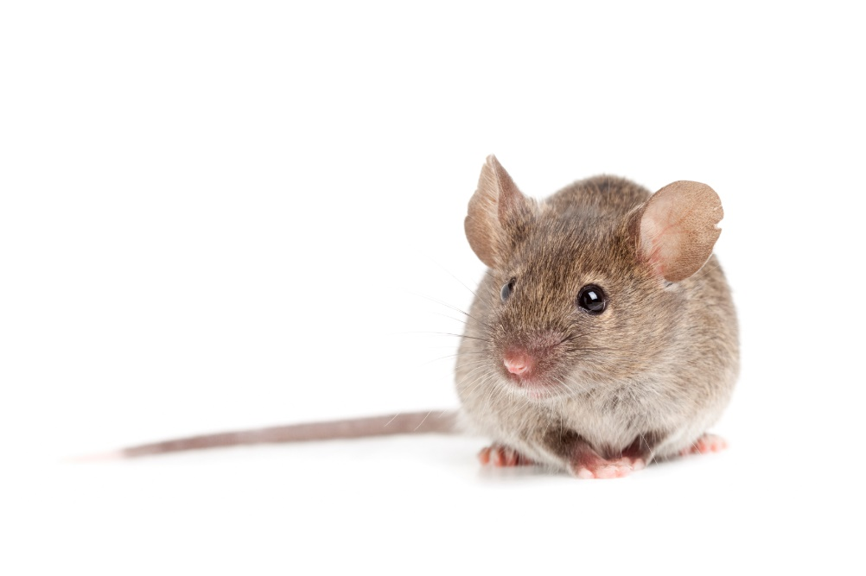
TRUE OR FALSE
Bats are rodents just like rats and mice?

Slide 5
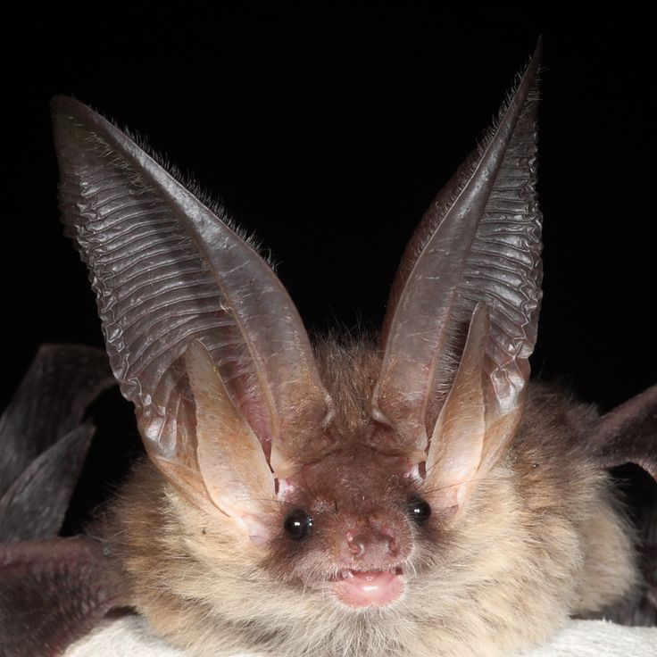
FALSE!
Bats are more related to dogs than they are to rats or mice.
Bats do not build nests, they don’t bring food into their roost and they only have 1 pup each year. year.

Slide 6
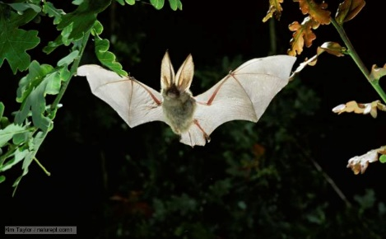
TRUE OR FALSE
Bats get tangled in your hair?

Slide 7
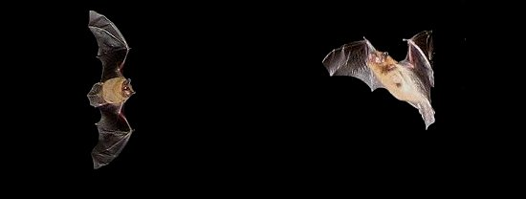
FALSE!
Bats may fly close to you to feed on the midges surrounding you. They are not trying to get into your hair.
A young bat learning to fly may collide with you – but very rarely and accidentally!

Slide 8

CAN YOU NAME THREE THINGS OUR BATS MIGHT EAT?

Slide 9
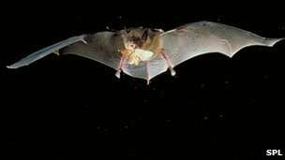
YOU COULD CHOOSE FROM ANY INVERTEBRATE!
MIDGES
MOTHS
SPIDERS
BEETLES
CENTIPEDES
DADDY LONG LEGS

Slide 10
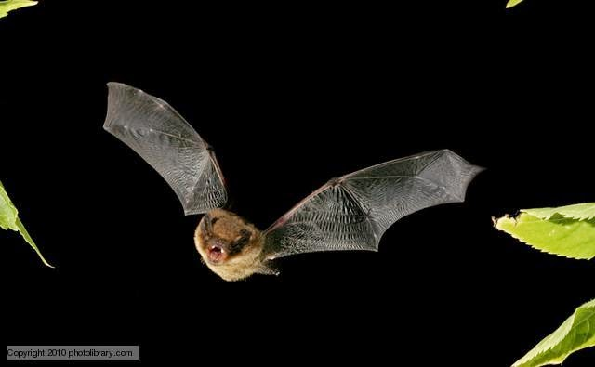
GUESS HOW MANY
How many midges does a bat eat in one night?

Slide 11
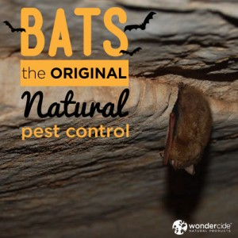
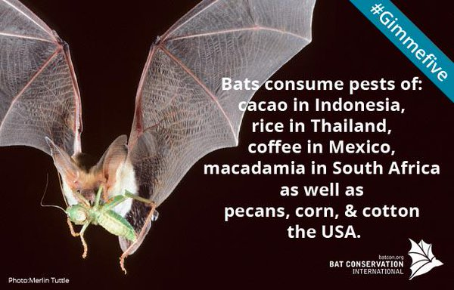
Over 3000!
Bats are the best natural pest controllers in the world

Slide 12
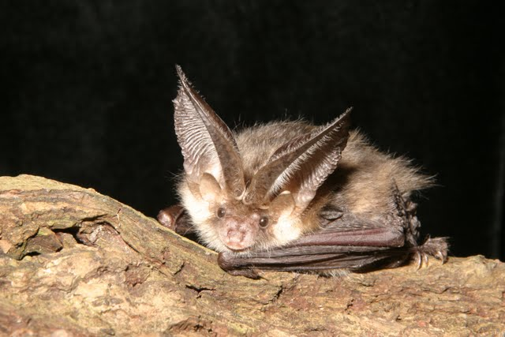
WELL DONE!!
Collect your prize!

